Slide 1


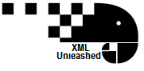
Introduction to XSLT for tei
Part 2: X-Path, Variables and Conditionals
A gentle introduction to stylesheets as adapted from the Women Writers Project and Further Adventures in XML

Slide 2
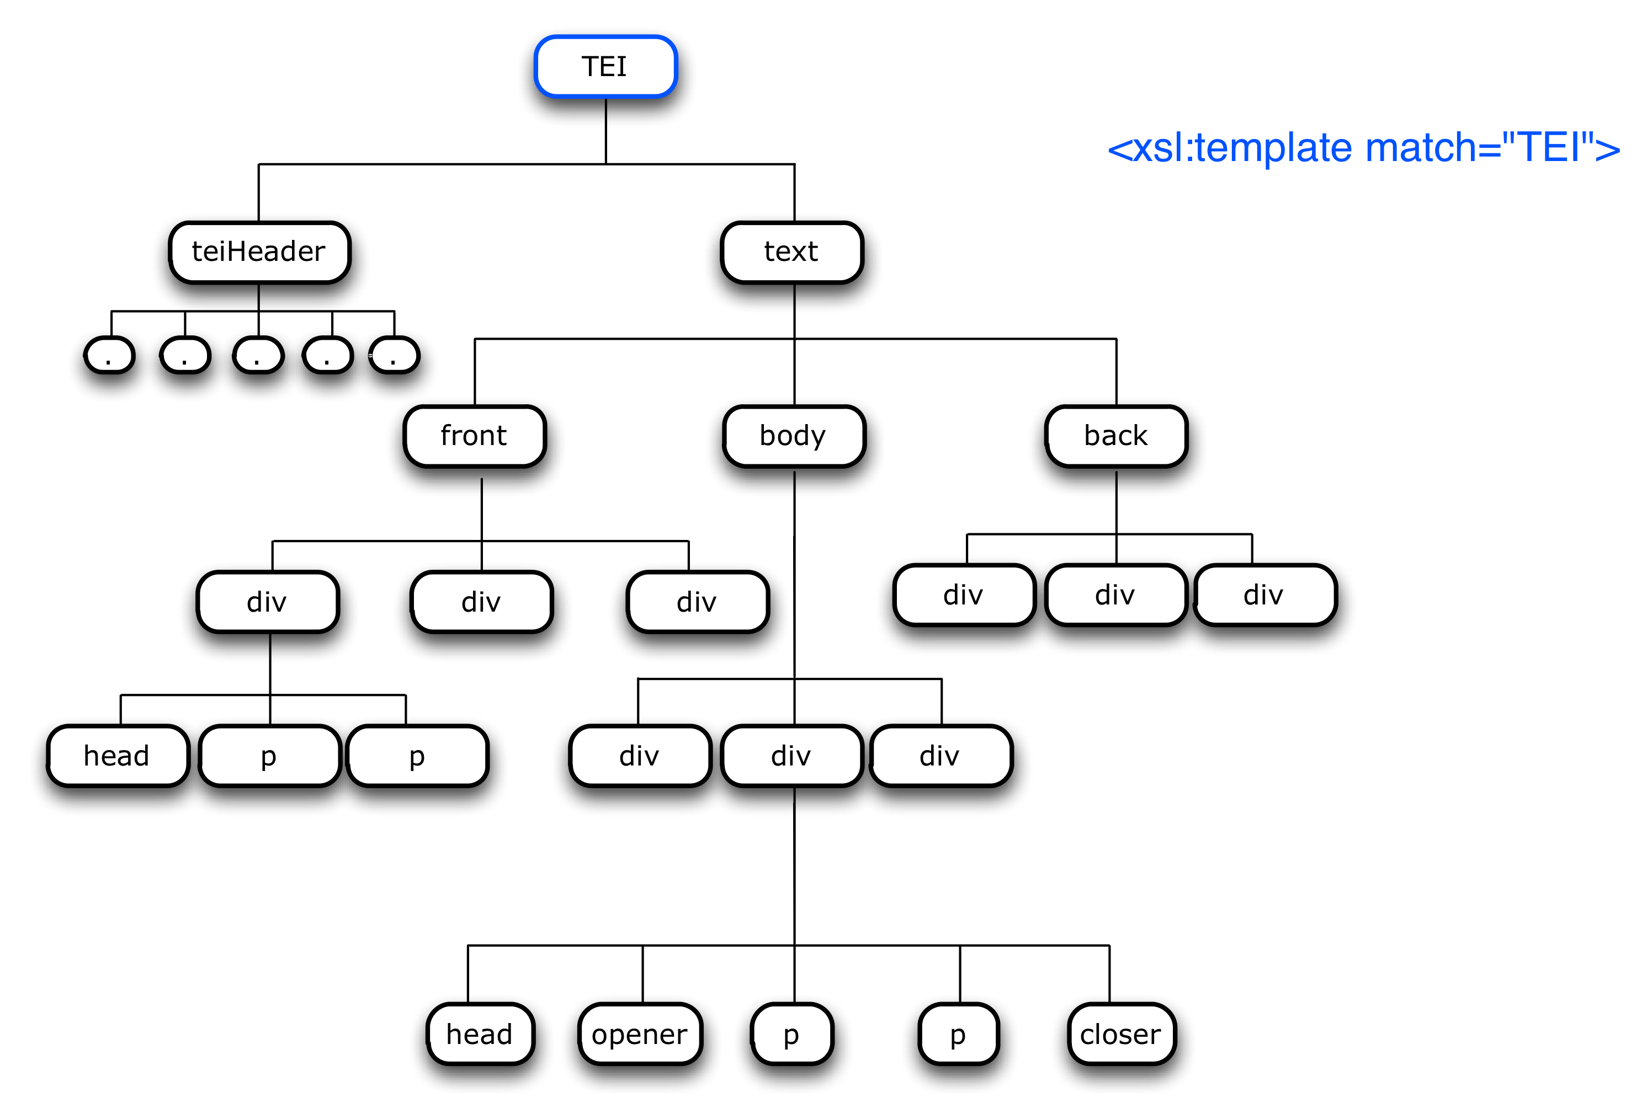
A Quick Recap
Rules in the stylesheet produce the output document
These rules are called templates
Each template has two parts
A pattern that identifies the nodes in the XML document that the template can be applied to
The instructions about the actual transformation
Key takeaways: <xsl:apply-templates/> triggers further processing– it sends us back to the source tree; and in XSLT only the best matching rule will be applied to any given node, and more specific rules are better matches than general rules like the default rules.
Notes:
Although templates can be empty, or contain nothing but strings, most will

Slide 3
Common xslt elements
Although templates can be empty, or contain nothing but strings, most will contain one or more XSLT elements (also called XSLT instructions) which describe how to select, sort, or further process nodes from the source tree. There are three XSLT elements that do much of the heavy lifting.

Slide 4
Common xslt elements: Apply-templates
<xsl:apply-templates select = “node-set-expression”/>
<xsl:apply-templates select="//last_name"/>, <xsl:apply-templates select="//first_name"/>.
When this XSLT element appears in a template, it tells the processor to compare each node identified by the select attribute against the templates in the style sheet, if a match is found, output the template for the matched node.
N.B. If the select is omitted, then all child elements, text, comments and processing instructions nodes of the context node should be processed. Attribute nodes will not be selected. (Remember your default processing rules!)

Slide 5
Common xslt elements: Value-of
<xsl:value-of select = “expression”/>
<xsl:template match="person"> <li> <xsl:value-of select="persName/surname"/> </li> </xsl:template>
When this XSLT element appears in a template, it tells the processor to compute the value of the selected node and copies into the output document. The item whose value is selected is relative to the current node (the item matched in the template).
How the value of the node is determined depends on the type of node. The most common type of node is an element, and the value of an element node is all of the text between the element’s start tag and end tag, with markup and comments stripped out.

Slide 6
Common xslt elements: For-Each
<xsl:for-each select = “node-set-expresion>
<xsl:for-each select="//person”>
<li>
<xsl:value-of select="persName/forename"/><xsl:text> </xsl:text>
<xsl:value-of select="persName/surname"/>
</li>
</xsl:for-each>
This element appears inside a template and iterates through a set of nodes. The select attribute establishes a new context node set, which can be useful for numbering, formatting lists, and calling special functions.

Slide 7
A gentle introduction to x-path
X-Path is a sophisticated language for marking locations and selecting sets of nodes with an XML document. The match and select patterns with XSL elements are X-Path expressions. They specify the location of the nodes we want to operate on, either with an absolute path that traces the location from the root node, or with a relative path that expresses the location in relation to the current or context node
An X-Path location is absolute if it begins with a slash (“/”) and relative otherwise.
Notes:
XML is a tree
TEI is parent
Think of lines as “I am a child”
We use xPath to crawl around the tree:
-match
-select
Slightly different in that when you use match without being explicitly clear, the implication is my child. What this means is that match and apply templates have a cascading effect.

Slide 8
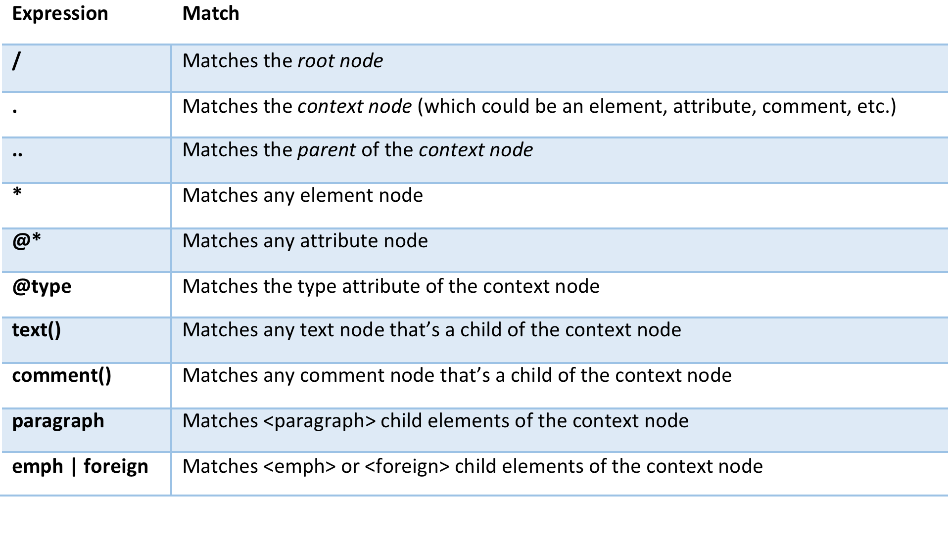
Some shorthand

Slide 9
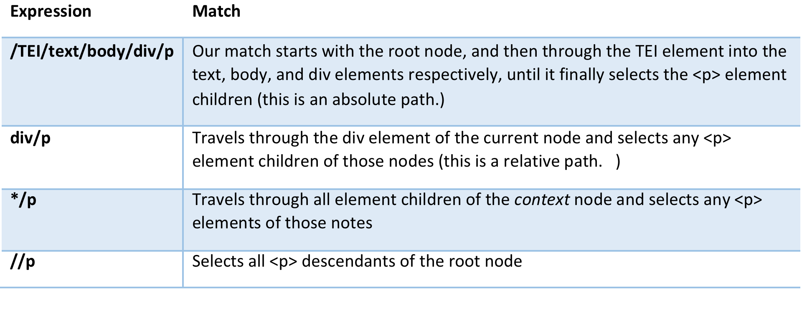
Some shorthand

Slide 10
Predicates
You can use a predicate to filter the results from your node tests. Predicates are evaluated as either true or false, and only true predicates are selected for your result set. Predicates are expressed within square brackets [] and are appended to your node test.
Sometimes it helps to think through your predicate with the statement: “Where it is true that…”

Slide 11
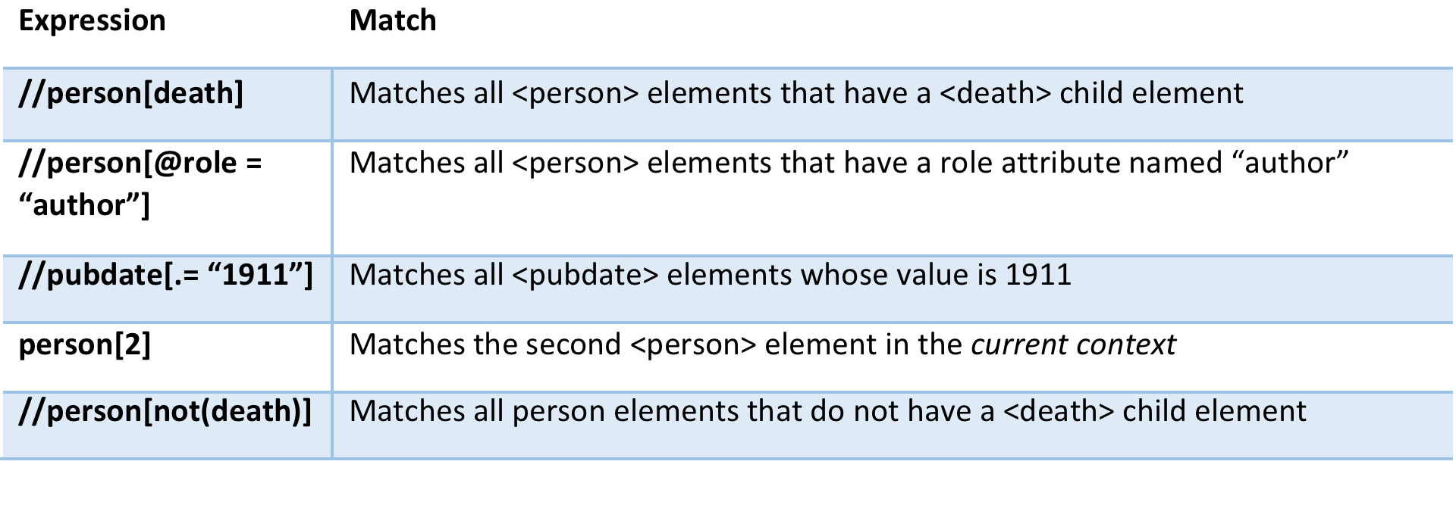
Predicates

Slide 12
Identifying the element to match
Notes:
XML is a tree
TEI is parent
Think of lines as “I am a child”
We use xPath to crawl around the tree:
-match
-select
Slightly different in that when you use match without being explicitly clear, the implication is my child. What this means is that match and apply templates have a cascading effect.

Slide 13
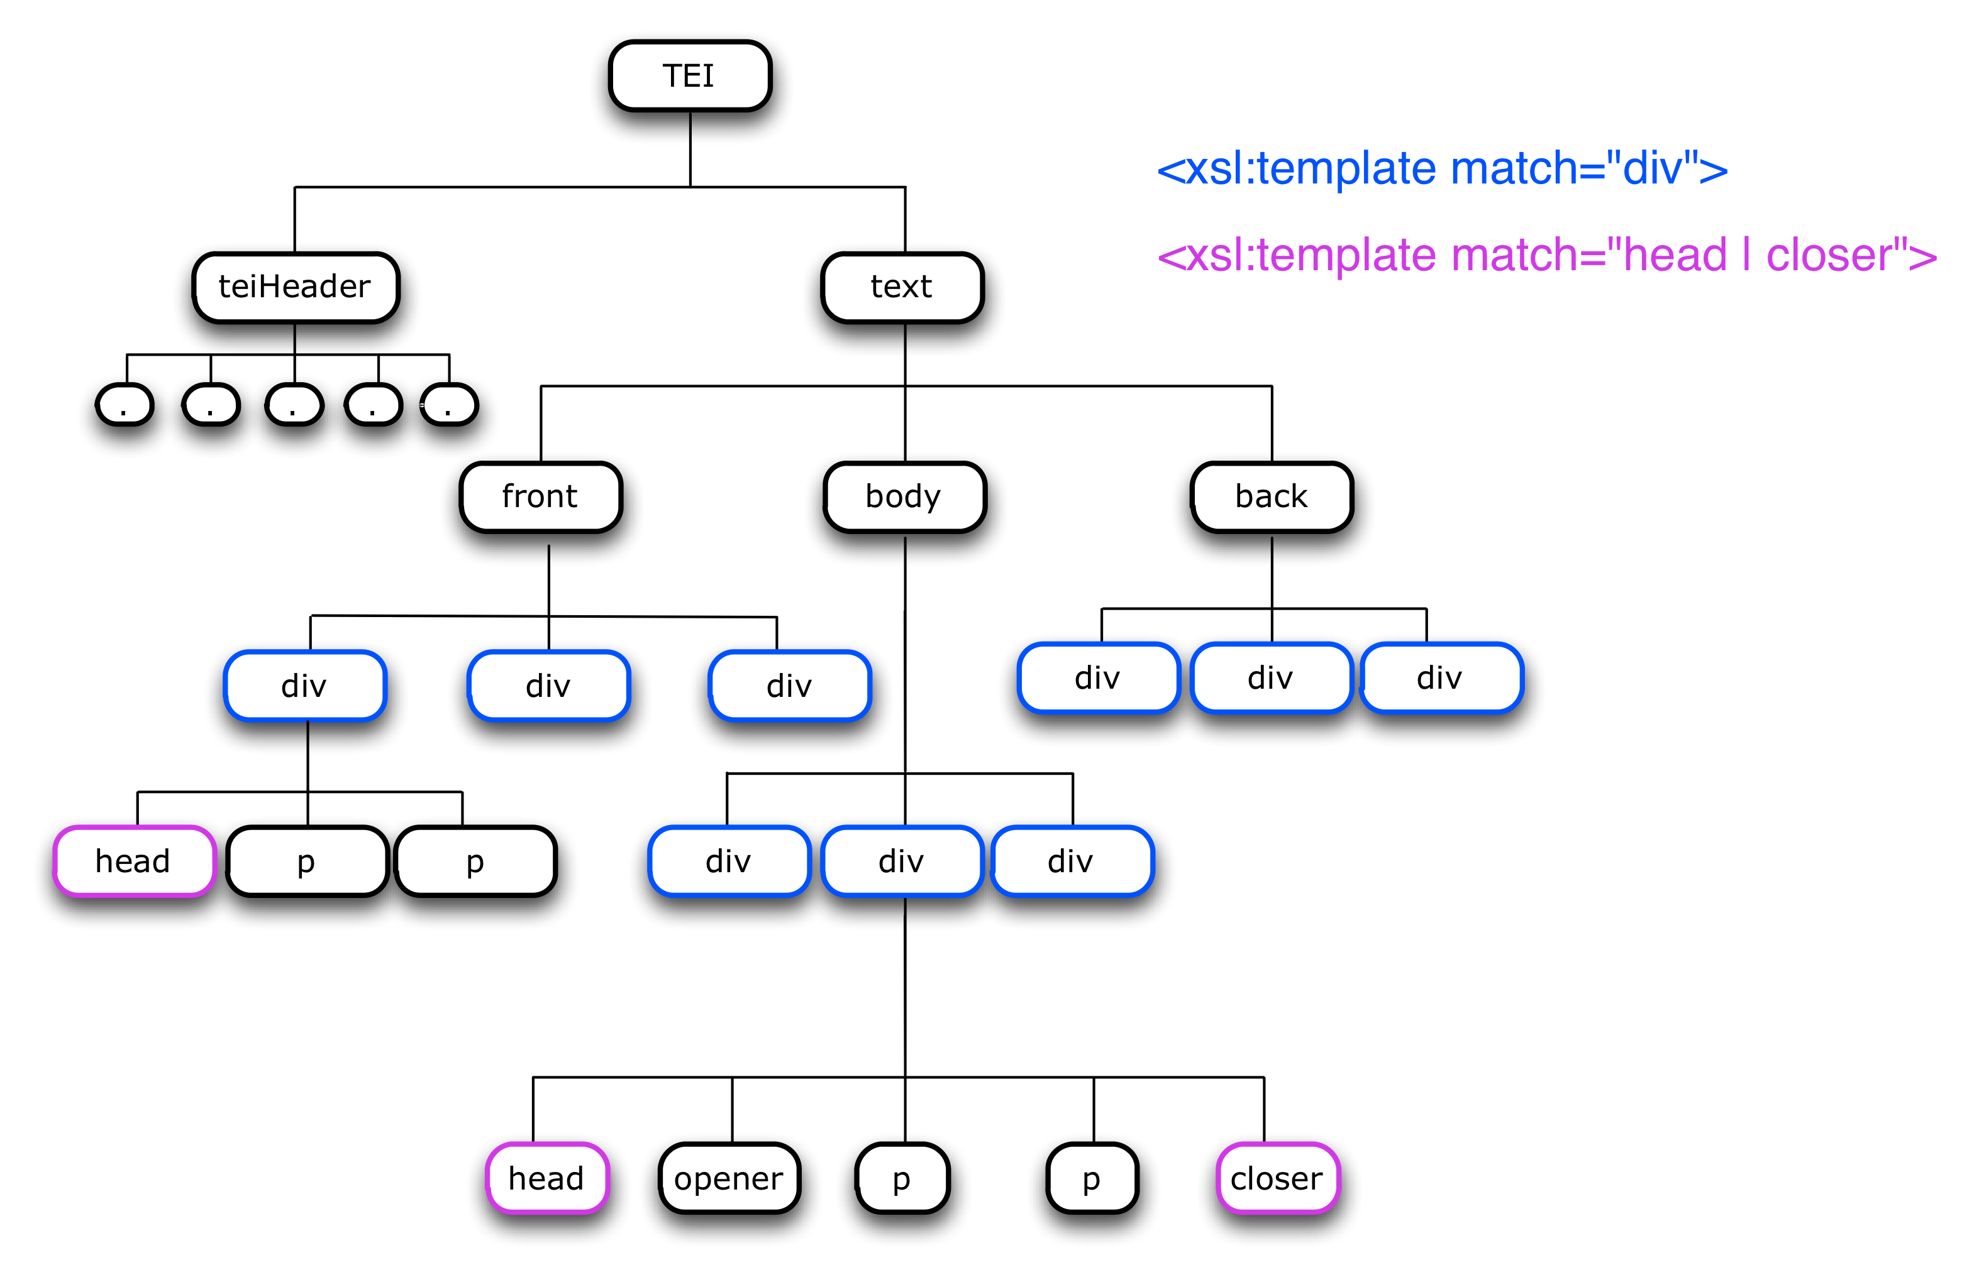
Identifying the elements to match: multiples
Notes:
| is or

Slide 14
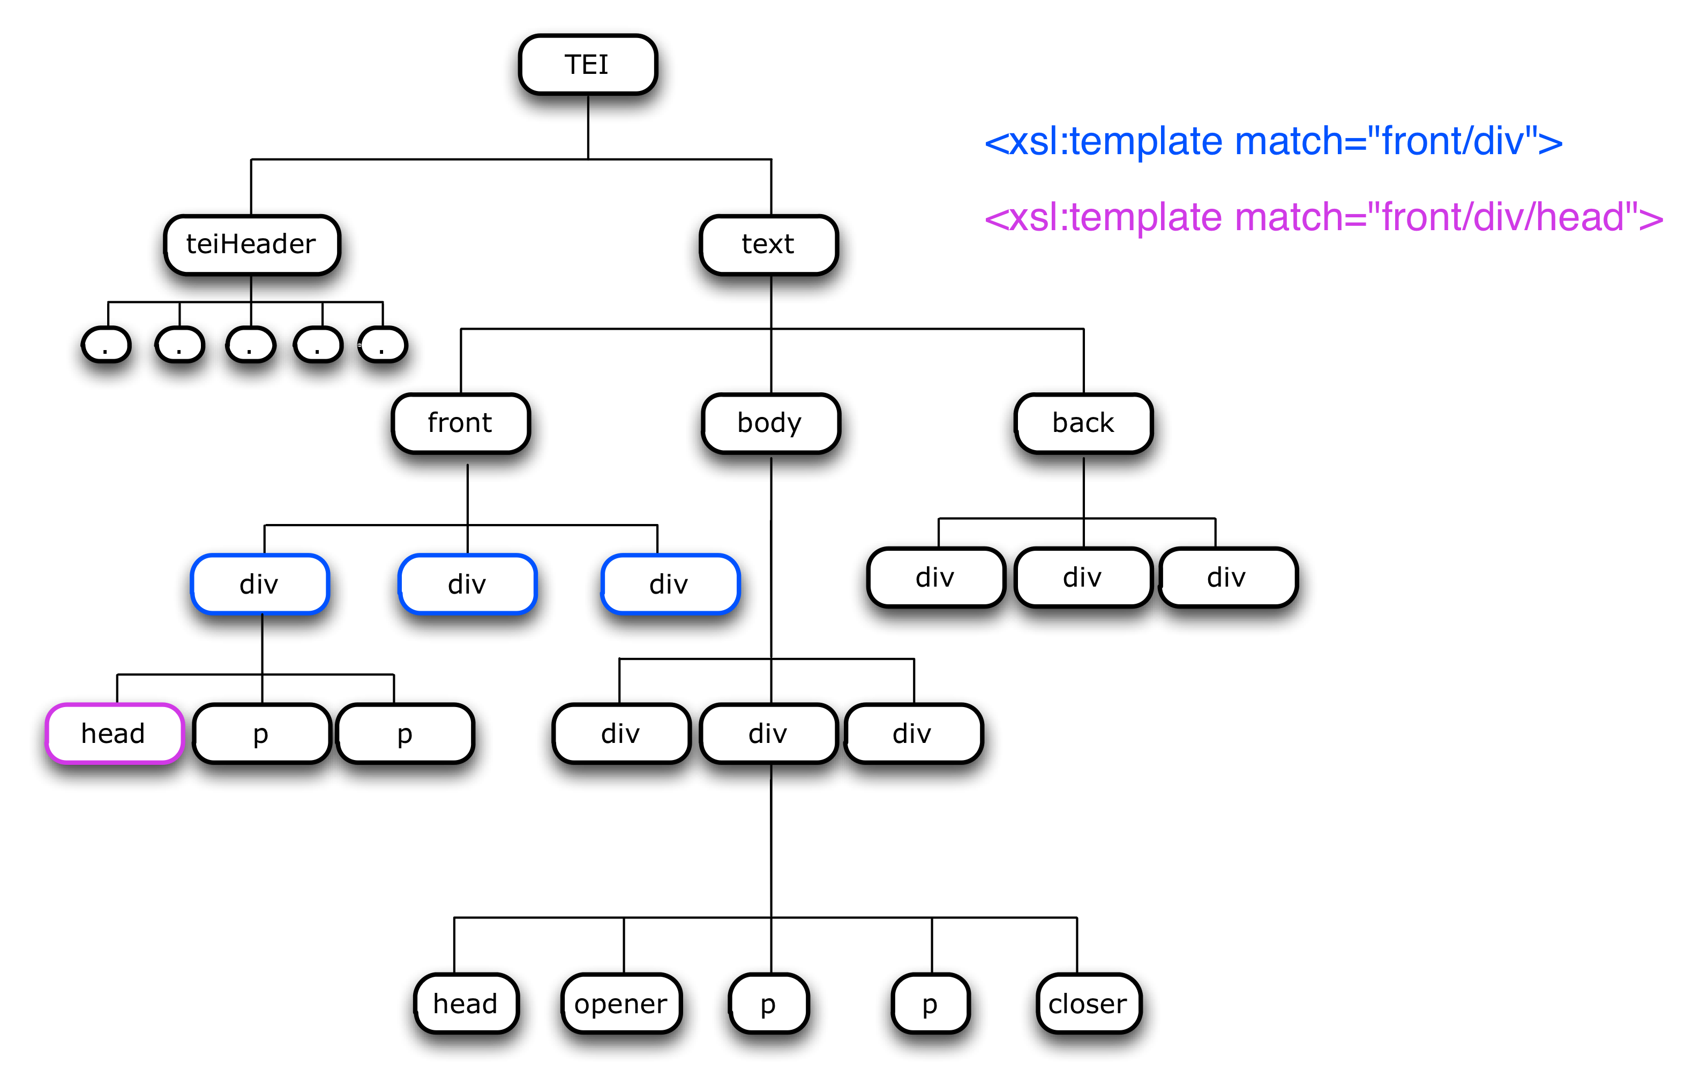
Identifying the element to match: context
Notes:
Note, when starting out, to make navigation easier, make it explicit, start from top.
// get all decendents
.. my parent of context

Slide 15
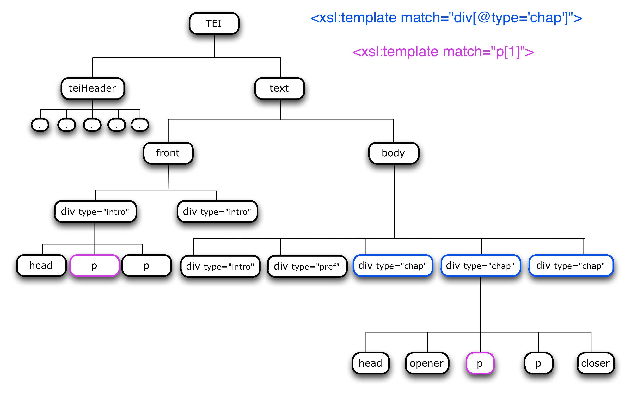
Some other useful patterns: attribute values, order of siblings
Notes:
[ ] are called predicates they are constraints that create a Boolean is it true or false, when you see them, say “where it is true that”
[1] first p element of context

Slide 16
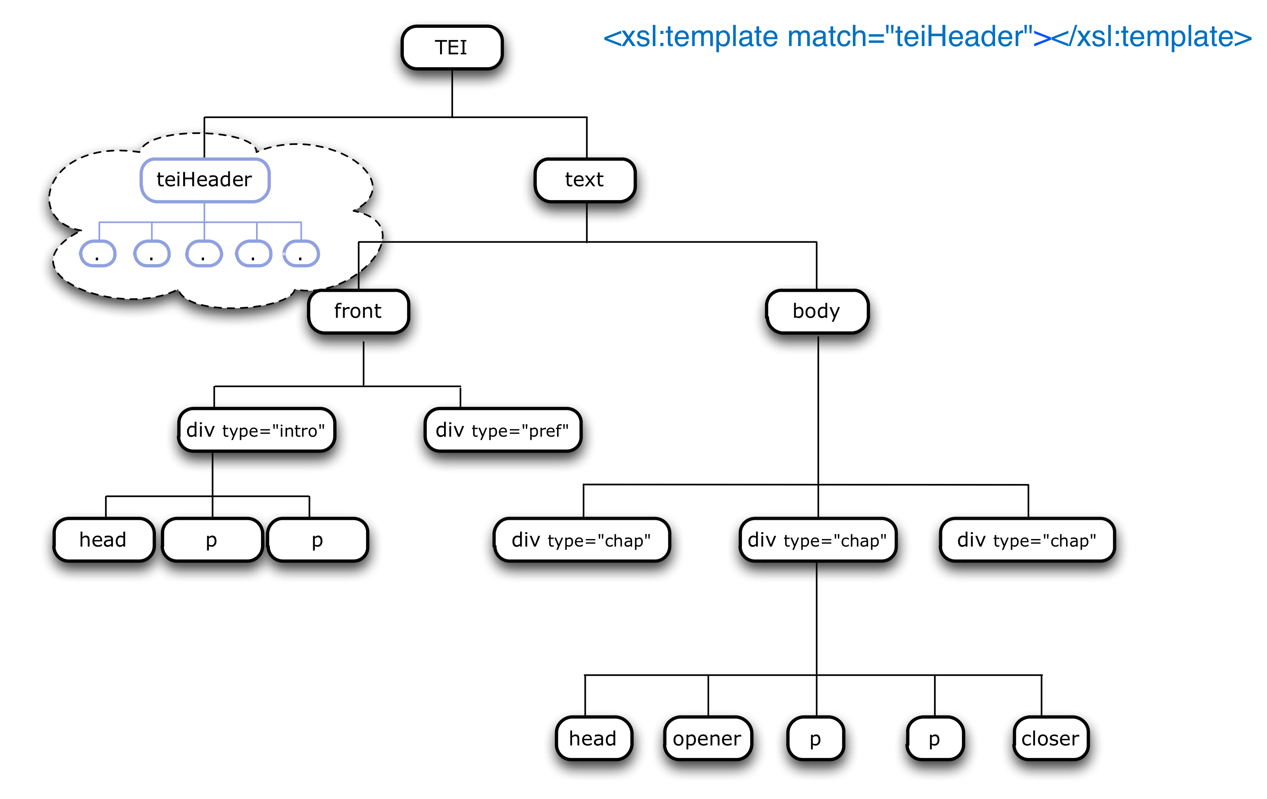
How to suppress parts of the input tree
<xsl:template match=“teiHeader”/>
Notes:
Prune the tree

Slide 17
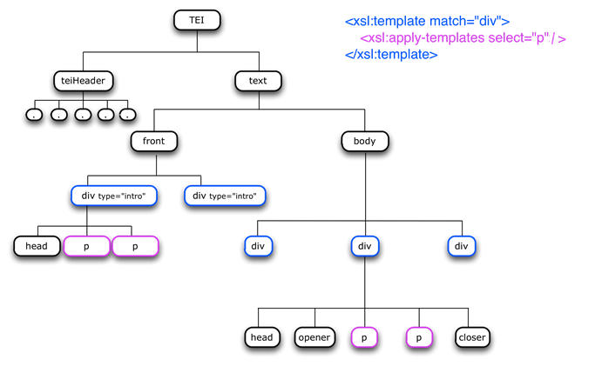
More complex navigation: the context node

Slide 18
More complex navigation
For more complex expressions (selecting ancestors or siblings, for example) the unabbreviated X-Path syntax is required. An unabbreviated expression consists of an axis, a double colon :: and the name/type of node[s] to be selected. Thus the following abbreviated expression:
<xsl:apply templates select= “div/p”>
Would look like this in unabbreviated syntax:
<xsl:apply templates select= “child::div/child::p”/>
Where child is an axis that describes a position relative to the current node, and p is the name of an element node.
There are 13 X-Path axes in all, including child, parent, self, ancestor, descendent, preceding-sibling, and following-sibling. Here is a quick explanation of the most commonly used axes.

Slide 19
More complex navigation
The child axis
This is the default axis when no axis is specified. It directs the XSLT processor down one-level in your document’s hierarchy.
The parent axis
The parent axis is the exact opposite of the child axis. It directs the XSLT processor to look up one level in your document, and retrieve the node that the current context is contained within. N.B. The root node does not have a parent, so the parent axis does not apply. Every other node in the tree will have exactly one parent.
The descendant axis
The child axis only directs your processor down one level. If you want to find the child of a child (and so on), you can use the descendant axis to direct your processor down, as far as the source document tree will allow, from the current context. If you are at the root node, the descendant axis will return all element and text nodes in your source document

Slide 20
More complex navigation
The ancestor axis
This is the opposite of the descendant axis. The ancestor axis directs your processor up through your document tree from the current context as far as the source document structure will allow. It will retrieve all parental nodes along the way.
The self axis
The self axis permits the processor to see only the current context
The following-sibling axis and The preceding-sibling axis
All the children of any given node (the parent) are siblings. If your current context is one of these siblings, you can examine siblings that come before you in the document structure (the preceding-sibling axis) or siblings that come after you in the document structure (the following-sibling axis).

Slide 21

Let’s try it out

Slide 22
XSL functions
Functions serve a wide range of purposes in XSLT. They can allow you to manipulate strings, perform mathematical operations, to count and assign numbers, and generate unique IDs. In this section we will look at a few of the most used functions that will help you perform some simple analysis of your text

Slide 23
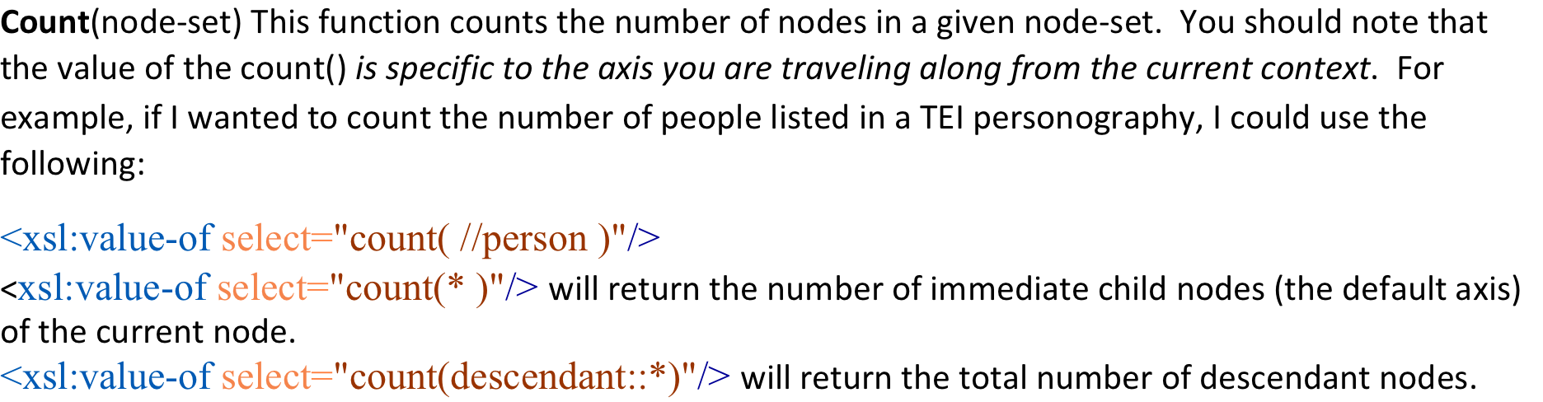
XSL functions

Slide 24
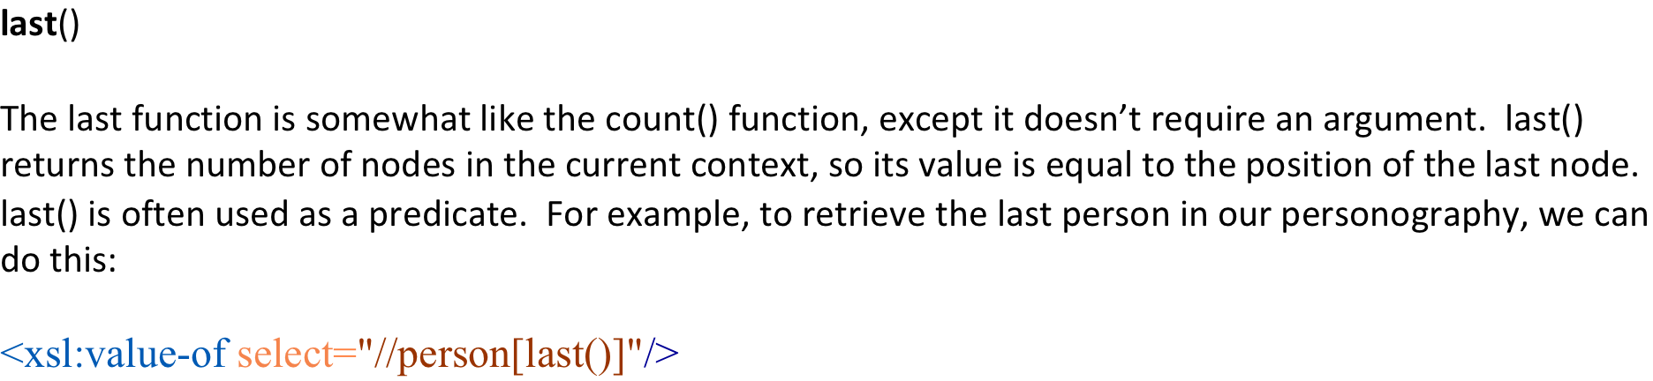
XSL functions

Slide 25
XSL functions
position()
The position() function returns the numeric position of the context node within the current node-set. Combined with the last() function, position() will allow you to map your document’s structure.
<xsl:for-each select="//person">
<li><xsl:value-of select="persName/forename"/> <xsl:text> </xsl:text><xsl:value-of select="persName/surname"/> is number <xsl:value-of select="position()"/> of <xsl:value-of select="last()"/></li>
</xsl:for-each>
This example is also a good example of how to use <xsl:for-each> to step through a set of nodes and process each one in turn. Because <xsl:for-each> changes the current context, it is especially effective when used in conjunction with functions like postion() and last(). When you are testing the position of a node within a group of related nodes, scooping them all up in an <xsl:for-each> seems more logical, and makes it easier to maintain and read the stylesheet.

Slide 26
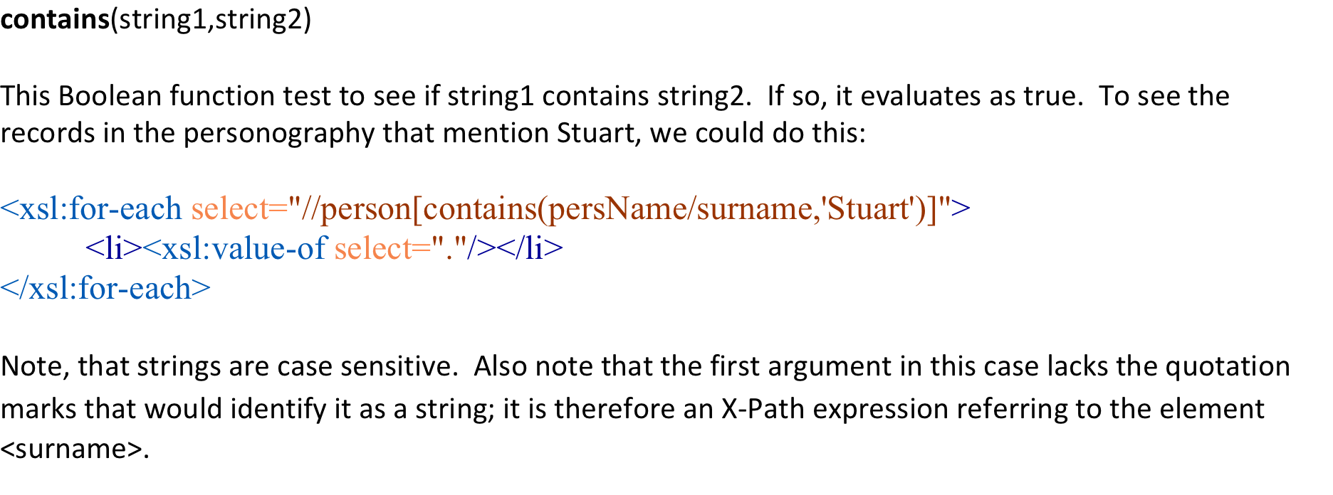
XSL functions

Slide 27
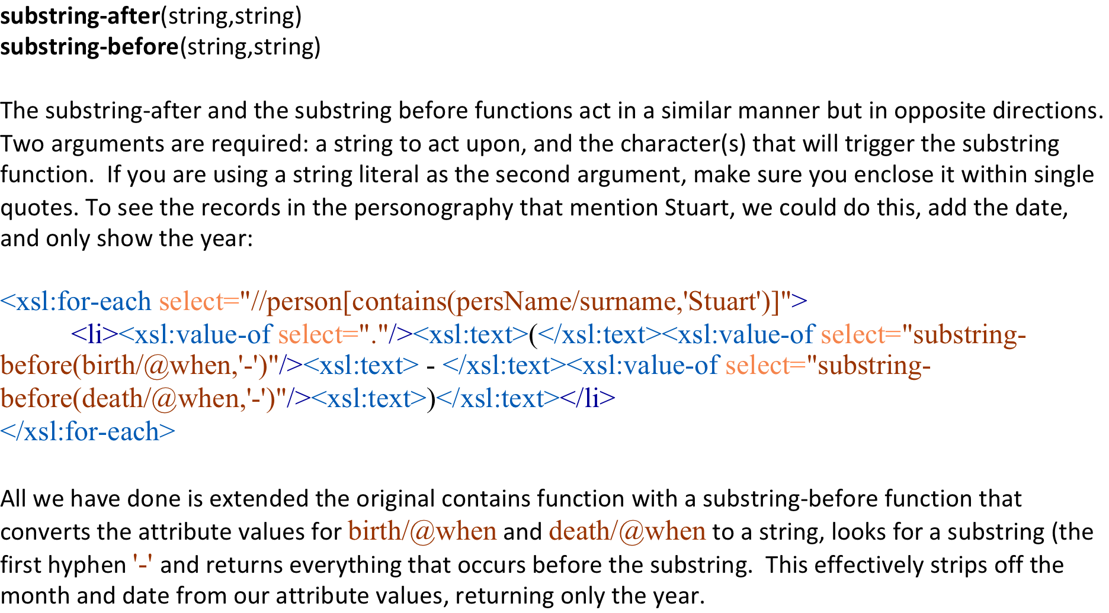
XSL functions

Slide 28
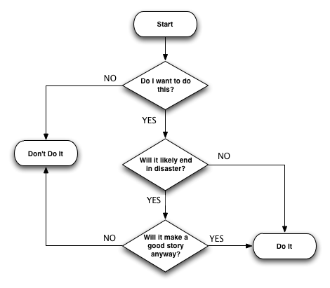
Conditionality and contingency

Slide 29
Conditionality and contingency
Almost all programming languages have conditional branching structures.
XSLT has two: xsl:if and xsl:choose

Slide 30
Using <xsl:if>
The <xsl:if> statement is a simple construct for testing certain conditions. It looks like this:
<xsl:if test= “some expression”>
[further instructions]
</xsl:if>
The expression being tested is evaluated and then converted to a Boolean value. If it evaluates true, the instructions with the <xsl:if> elements will be processed; if the test is false, those instructions are ignored. To create more complex conditional statements, XSLT provides the <xsl:choose> element.

Slide 31
Using <xsl:choose>
Each <xsl:choose> element contains at least one <xsl:when> statement, which follows the same syntax as the <xsl:if> statements. The processor evaluates each <xsl:when> statement in order, looking for one that evaluates to true. As soon as a true value is found, the instructions inside that <xsl:when> statement are executed and the <xsl:choose> is not processed any further. If none of the <xsl:when> statements are true, the <xsl:otherwise> statement will be executed if found; if not, nothing happens.

Slide 32
XSL Choose:Example
<xsl:choose>
<xsl:when test="count( //person[ not( death ) ] ) lt 2">
<p>Of those people, <xsl:value-of select="count( //person[ not( death ) ] )"/> is still alive.</p>
</xsl:when>
<xsl:otherwise>
<p>Of those people, <xsl:value-of select="count( //person[ not( death ) ] )"/> are still alive.</p>
</xsl:otherwise>
</xsl:choose>

Slide 33
XSL variables
useful
shorthand reference
to set
<xsl:variable name="whatever" select="XPath"/>
to reference
$whatever (in an XPath, e.g. in a select)

Slide 34
XSL variables:Example
<xsl:stylesheet version="2.0" xmlns:xsl="http://www.w3.org/1999/XSL/Transform" xmlns:tei="http://www.tei-c.org/ns/1.0" xmlns:xhtml="http://www.w3.org/1999/xhtml" xmlns="http://www.w3.org/1999/xhtml" xpath-default-namespace="http://www.tei-c.org/ns/1.0"> <xsl:output method="xhtml" doctype-public="-//W3C/DTD XHTML 1.0 STRICT//EN" doctype-system="http://www.w3.org/TR/xhtml1/DTD/xhtml1-strict.dtd" encoding="UTF-8" indent="yes"/>
<!-- Variables for counting -->
<xsl:variable name="supplied_undefined" select="count(//supplied[@reason='undefined'])"/> <xsl:variable name="supplied_lost" select="count(//supplied[@reason='lost'])"/>
Namespace
Output
Variables

Slide 35
XSL variables:Example
<xsl:choose> <xsl:when test="$supplied_lost lt 2"> <p>Of those, <xsl:value-of select="$supplied_lost"/> is a lost element;</p> </xsl:when> <xsl:otherwise> <p>Of those, <xsl:value-of select="$supplied_lost"/> are lost elements;</p> </xsl:otherwise> </xsl:choose> <xsl:choose> <xsl:when test="$supplied_undefined lt 2"> <p> and <xsl:value-of select="$supplied_undefined"/> is an undefined element.</p> </xsl:when> <xsl:otherwise><p> and <xsl:value-of select="$supplied_undefined"/> are undefined elements.</p>
</xsl:otherwise> </xsl:choose>

Slide 36
Let’s try it out

